Slide 1

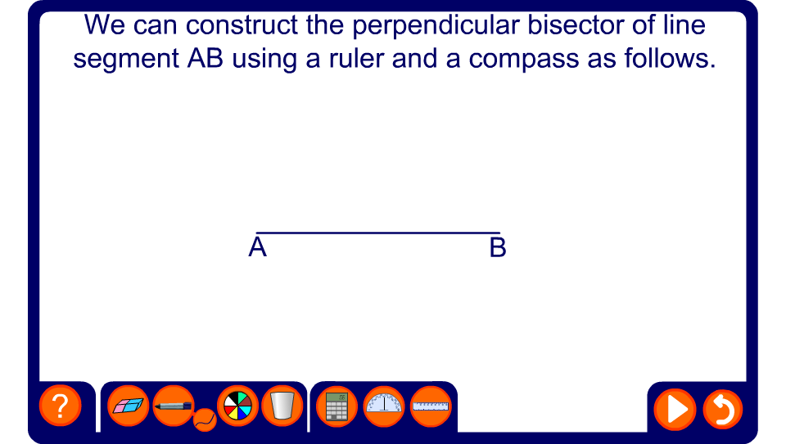


The perpendicular bisector of a line
Notes:
Ask pupils how we could add lines to this diagram to make a rhombus.
The orange line, the perpendicular bisector, forms the set of points, or locus, of the points that are equidistant from points A and B.
Remind pupils that construction lines should not be rubbed out.

Slide 2
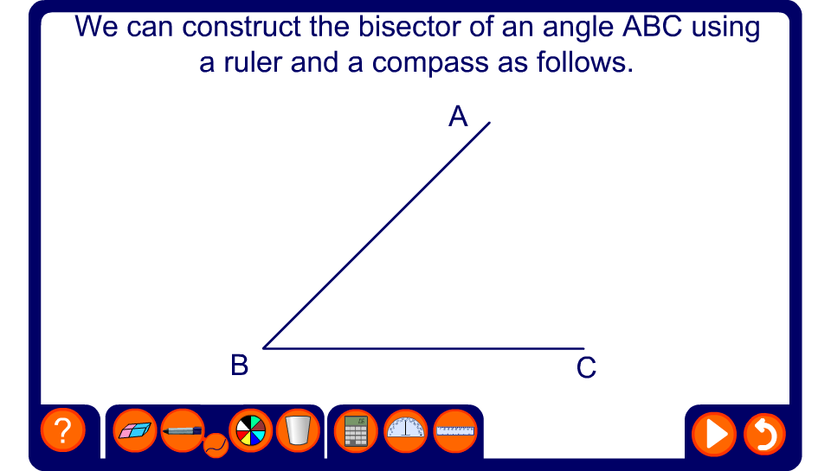
The bisector of an angle
Notes:
When the diagram is complete ask pupils to name the two equal angles. These are angle ABR and angle RBC.

Slide 3
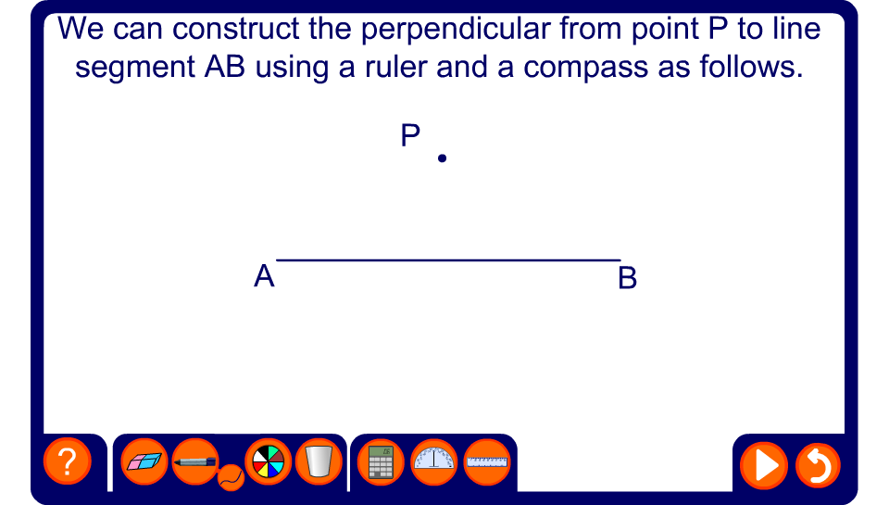
The perpendicular from a point to a line

Slide 4
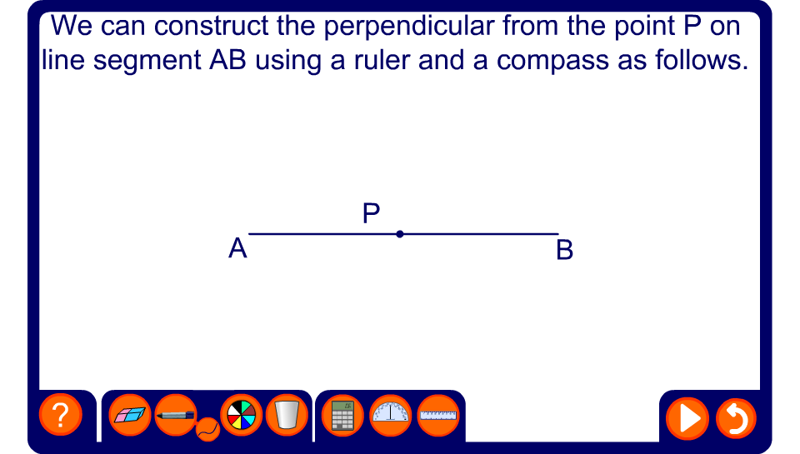
The perpendicular from a point on a line

